Slide 1
Review of the 2022-2023 Opening Letter and Oversight Updates
October 13, 2022
Charter Schools Division
Notes:
Line spacing + Page numbers

Slide 2
Welcome
1

Slide 3
Agenda
1 Welcome – José J. Cole-Gutiérrez
2 Opening Letter – Dana K. Edlis
3 Oversight Report Updates: Instructional – Christine Kae
4 Oversight Report Updates: Fiscal – Lillian L. Lee and Allan Villamor
5 Attachment H: Facilities – Marla Willmott
6 Vendor Certification and DOJ Form – Marla Willmott
7 Q and A

Slide 4
Opening Letter
2

Slide 5
Opening Letter

Slide 6
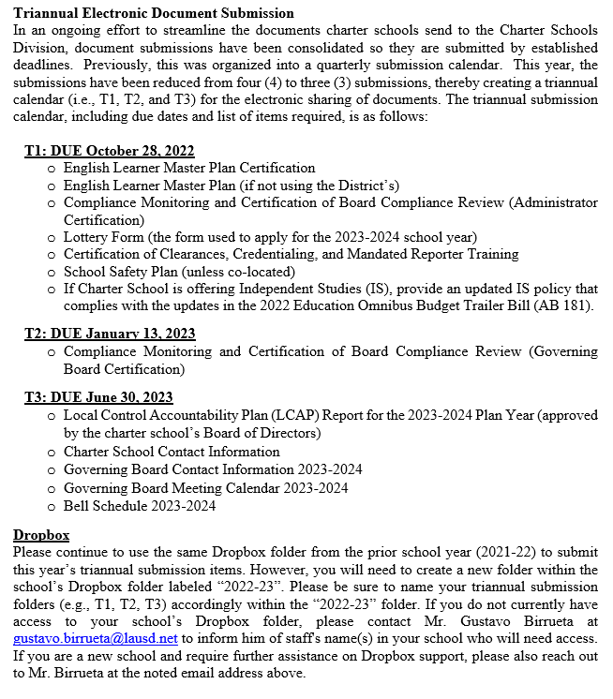
Opening Letter

Slide 7
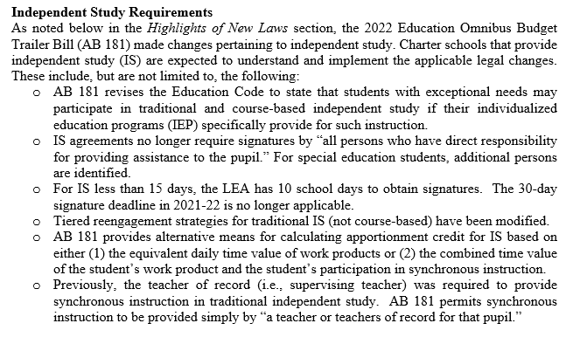
Opening Letter

Slide 8
Oversight Report Updates Instructional
3

Slide 9
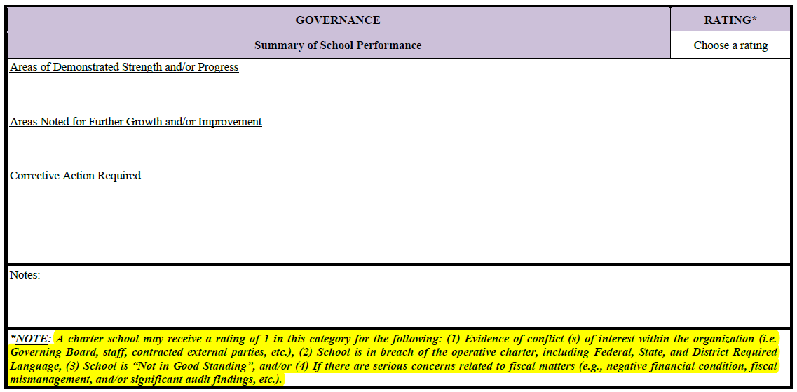
Annual Performance-Based Oversight Report 2022-2023 Governance
Overall category score impact: A charter school may receive a rating of “1” in this category for the following:
Conflict(s) of interest
Breach of the operative charter, including Federal, State, and District Required Language
Not in Good Standing
Serious fiscal concerns

Slide 10
Annual Performance-Based Oversight Report 2022-2023 Student Achievement and Educational Performance
Due to the suspension of reporting state measures on the 2021 California School Dashboard, color-coded performance level will not be issued.
Indicators in this category will be scored based on 2022 Status level, except for the College/Career Indicator

Slide 11
Annual Performance-Based Oversight Report 2022-2023 Student Achievement and Educational Performance
A1-A3 and A7 Dashboard Indicator Status will be scored as follows:
4: Very High
3: High or Medium and at/above statewide DFS
2: Medium and below statewide DFS or Low
1: Very Low

Slide 12
Annual Performance-Based Oversight Report 2022-2023 Student Achievement and Educational Performance
A5-A6 Dashboard Indicator Status will be scored as follows:
4: Very Low
3: Low or Medium and at/below statewide DFS
2: Medium and above statewide DFS or High
1: Very High

Slide 13
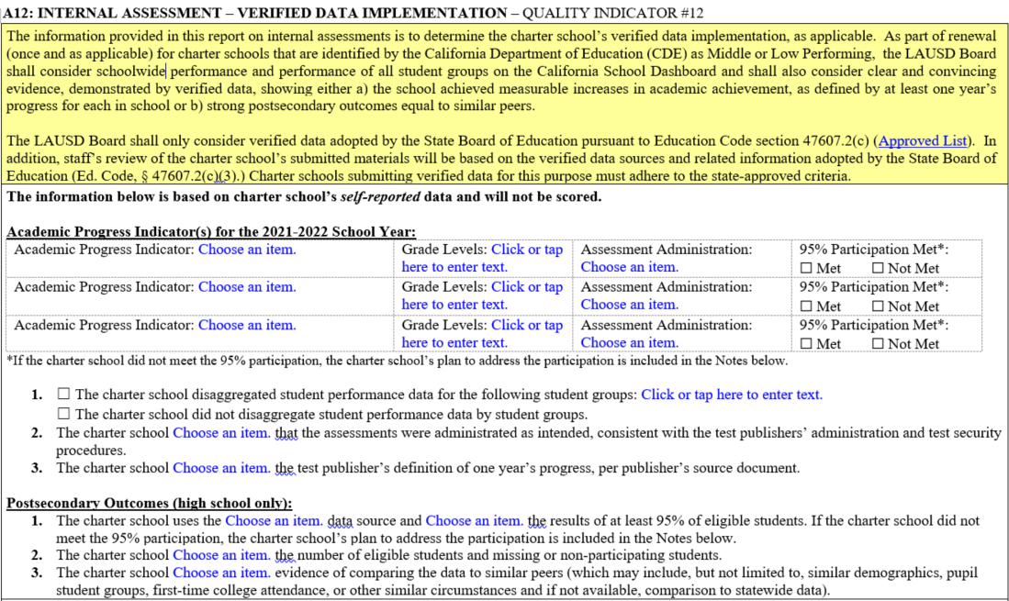
Annual Performance-Based Oversight Report 2022-2023 Student Achievement and Educational Performance
A12 Internal Assessment/Verified Data Implementation is based on school’s self-reported data and response to guiding questions, and will not be scored.
Notes:
The information is to determine the charter school’s verified data implementation, as applicable.
For schools identified by the CDE as Middle or Low Performing at the time of renewal, the LAUSD Board shall consider performance on the California School Dashboard and verified data (which adhere to the state-approved criteria)
Note: The LAUSD Board shall only consider verified data adopted by the State Board of Education.

Slide 14
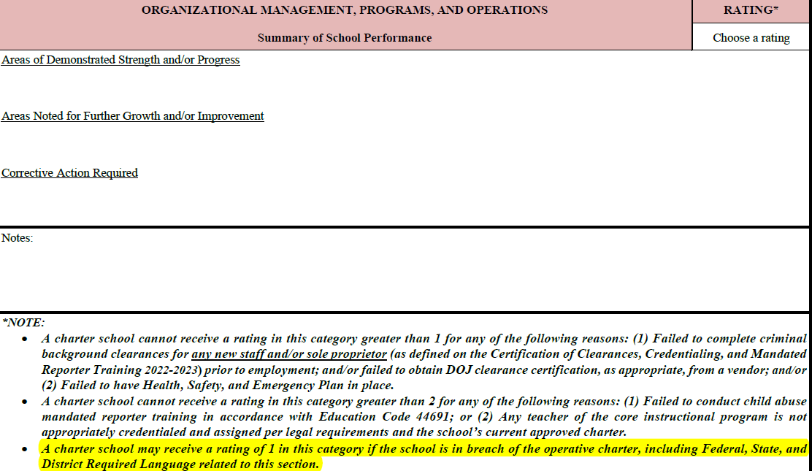
Annual Performance-Based Oversight Report 2022-2023 Organizational Management, Programs and Operations
Overall category score impact: A charter school may receive a rating of “1” in this category for breach of the operative charter, including Federal, State, and District Required Language

Slide 15
Annual Performance-Based Oversight Preparation Guide 2022-2023
Five business days prior to the visit, provide all documents in Dropbox
Logistics, Binder 1, Binder 2, Binder 3, and Binder 3A
Updated School Internal Assessment-Verified Data Implementation information and submission

Slide 16
Oversight Report Updates Fiscal
4

Slide 17
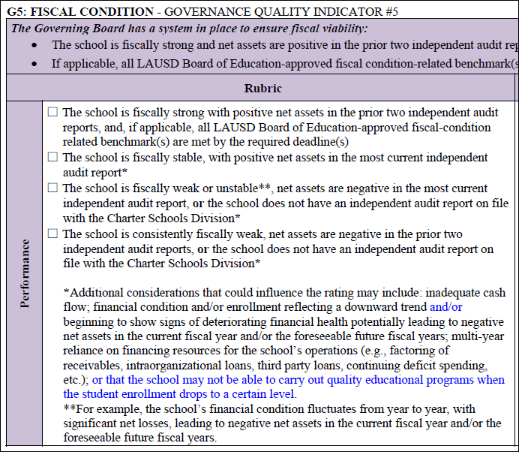
G5 – Fiscal Condition

Slide 18
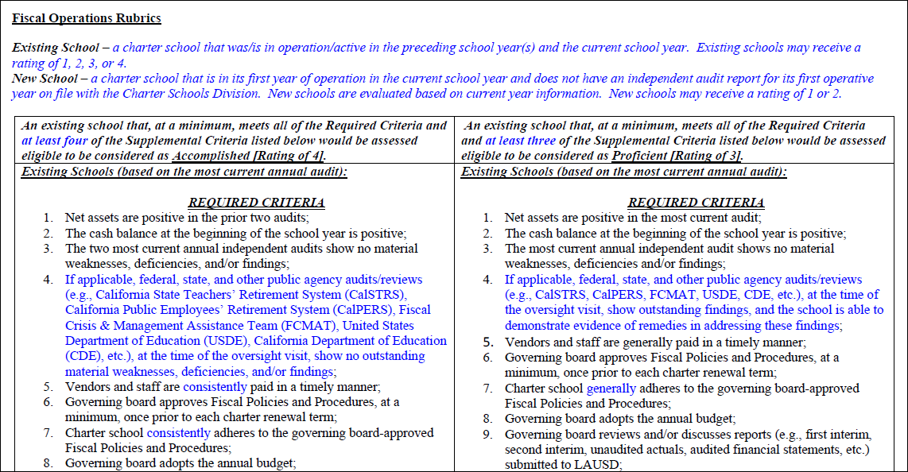
Fiscal Operations Rubrics
Accomplished [Rating of 4] and Proficient [Rating of 3]

Slide 19
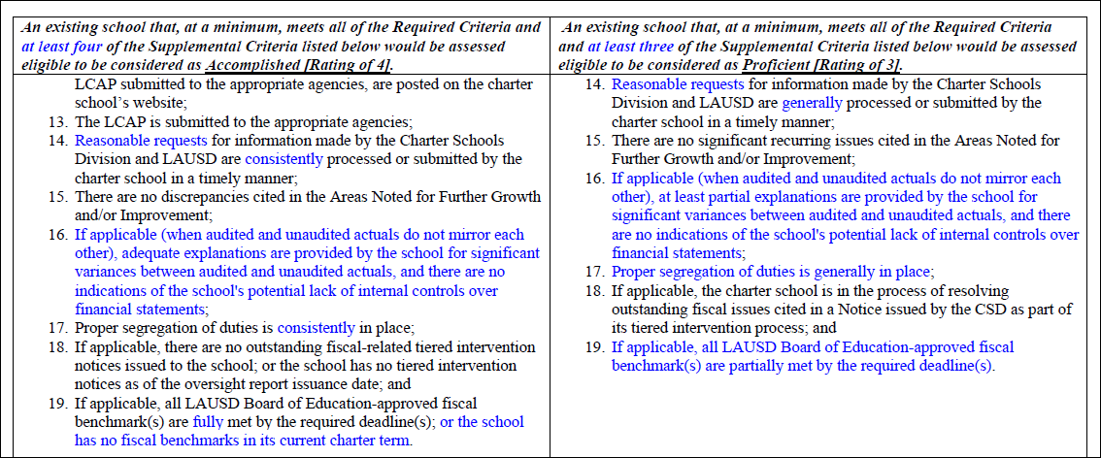
Fiscal Operations Rubrics (cont.)
Accomplished [Rating of 4] and Proficient [Rating of 3]

Slide 20
Fiscal Operations Rubrics (cont.)
Accomplished [Rating of 4] and Proficient [Rating of 3]

Slide 21
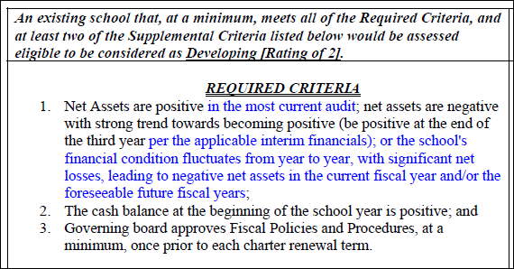
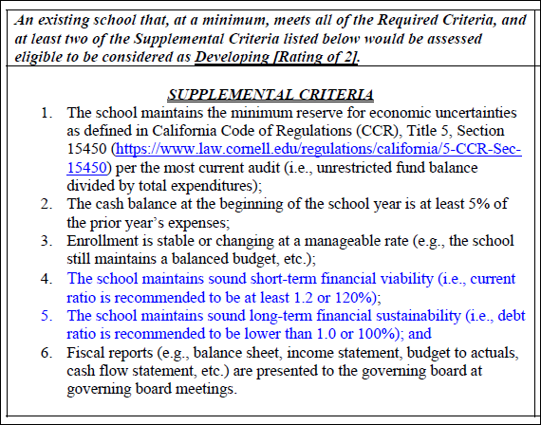
Fiscal Operations Rubrics (cont.)
Existing School – Developing [Rating of 2]

Slide 22
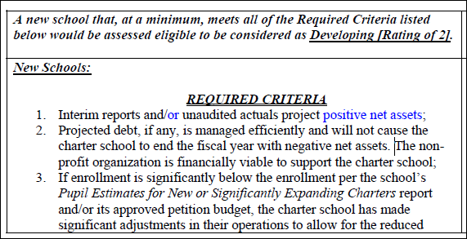
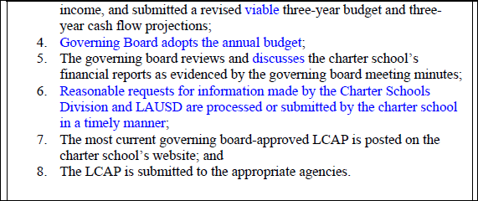
Fiscal Operations Rubrics (cont.)
New School – Developing [Rating of 2]

Slide 23
Fiscal Operations Preparation Guide 2022-2023

Slide 24
Fiscal Operations Preparation Guide 2022-2023 (cont.)

Slide 25
Fiscal Operations Preparation Guide 2022-2023 (cont.)

Slide 26
Fiscal Operations Preparation Guide 2022-2023 (cont.)

Slide 27
Attachment H: Facilities
5

Slide 28
Attachment H Facilities Information Updates
Fire Permit Requirements for non-district facilities
Charter School Compliance Monitoring Document, item 11, has been updated to reflect the requirement that a comprehensive fire life safety inspection is conducted annually
Certified Accessibility Plan on non-district facilities
This is not a new requirement, but charter schools will be asked to provide a status update during the 2022-2023 school year

Slide 29
Vendor Certification and DOJ Form
6

Slide 30
Minor Updates to the Following Documents
Attachment C-Criminal Background Clearance Certification
Minor update to add the word “District.”
Attachment D-Vendor Certification
Updated document was sent on 9-27-2022 (with revised date of 9/27/2022)-updates from 1-10-2022 document are minimal with only a date change in the example. Charter Schools do not have to update current vendor certifications to the 9/27/2022 form, but should use it moving forward.

Slide 31
Q and A
7

Slide 32
THANK YOU!

